Slide 1
Introduction to AI
Russell and Norvig:
Chapter 1

Slide 2
What is AI? Found on the Web …
AI is the simulation of intelligent human processes
AI is the reproduction of the methods or results of human reasoning or intuition
AI is the study of mental faculties through the use computational methods
Using computational models to simulate intelligent behavior
Machines to emulate humans
Intelligent
behavior
Computer
Humans

Slide 3
Why AI?
Cognitive Science: As a way to understand how natural minds and mental phenomena work
e.g., visual perception, memory, learning, language, etc.
Philosophy: As a way to explore some basic and interesting (and important) philosophical questions
e.g., the mind body problem, what is consciousness, etc.
Engineering: To get machines to do a wider variety of useful things
e.g., understand spoken natural language, recognize individual people in visual scenes, find the best travel plan for your vacation, etc.

Slide 4
Weak vs. Strong AI
Weak AI: Machines can be made to behave as if they were intelligent
One might say that to solve a hard problem, you have to almost know the answer already.
Strong AI: Machines can have consciousness
subject of fierce debate, usually among philosophers and nay-sayers, not so much among AI researchers!

Slide 5
AI Characterizations
Discipline that systematizes and automates intellectual tasks to create machines that:
Act like humans | Act rationally
Think like humans | Think rationally

Slide 6
Act Like Humans
AI is the art of creating machines that perform functions that require intelligence when performed by humans
Methodology: Take an intellectual task at which people are better and make a computer do it
Turing test
Prove a theorem
Play chess
Plan a surgical operation
Diagnose a disease
Navigate in a building

Slide 7
Turing Test
Interrogator interacts with a computer and a person via a teletype.
Computer passes the Turing test if interrogator cannot determine which is which.
Loebner contest: Modern version of Turing Test, held annually, with a $100,000 prize. http://www.loebner.net/Prizef/loebner-prize.html
Participants include a set of humans and a set of computers and a set of judges.
Scoring: Rank from least human to most human.
Highest median rank wins $2000.
If better than a human, win $100,000. (Nobody yet…)

Slide 8
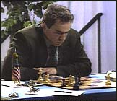
Chess
Name: Garry Kasparov
Title: World Chess
Champion
Crime: Valued greed
over common sense
Humans are still better at making up excuses.
© Jonathan Schaeffer

Slide 9
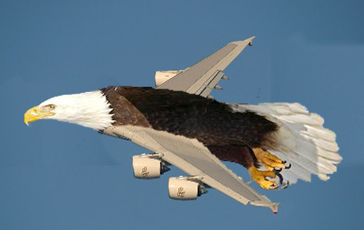
Perspective on Chess: Pro
“Saying Deep Blue doesn’t really think about chess is like saying an airplane doesn't really fly because it doesn't flap its wings”
Drew McDermott
© Jonathan Schaeffer

Slide 10
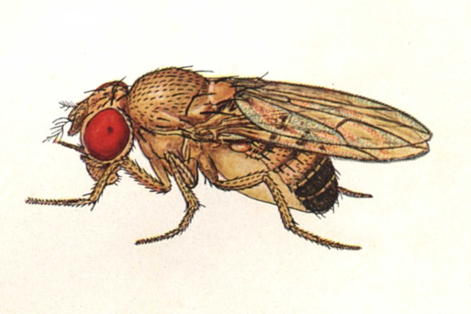
Perspective on Chess: Con
“Chess is the Drosophila (a kind of fruit fly) of artificial intelligence. However, computer chess has developed much as genetics might have if the geneticists had concentrated their efforts starting in 1910 on breeding racing Drosophila. We would have some science, but mainly we would have very fast fruit flies.”
John McCarthy
© Jonathan Schaeffer

Slide 11
Think Like Humans
Connection with Psychology
General Problem Solver (Newell and Simon)
Neural networks
Reinforcement learning
How the computer performs functions does matter
Comparison of the traces of the reasoning steps
Cognitive science → testable theories of the workings of the human mind
But:
Role of physical body, senses, and evolution in human intelligence?
Do we want to duplicate human imperfections?

Slide 12
Think/Act Rationally
Always make the best decision given what is available (knowledge, time, resources)
Perfect knowledge, unlimited resources → logical reasoning
Imperfect knowledge, limited resources → (limited) rationality
Connection to economics, operational research, and control theory
But ignores role of consciousness, emotions, fear of dying on intelligence

Slide 13

Dartmouth Conference 1956: The Birth of AI
The Dartmouth Conference of 1956^{[40]} was organized by Marvin Minsky, John McCarthy and two senior scientists: Claude Shannon and Nathan Rochester of IBM. The proposal for the conference included this assertion: "every aspect of learning or any other feature of intelligence can be so precisely described that a machine can be made to simulate it".^{[41]} The participants included Ray Solomonoff, Oliver Selfridge, Trenchard More, Arthur Samuel, Allen Newell and Herbert Simon, all of whom would create important programs during the first decades of AI research.^{[42]} At the conference Newell and Simon debuted the "Logic Theorist" and McCarthy persuaded the attendees to accept "Artificial Intelligence" as the name of the field.^{[43]} The 1956 Dartmouth conference was the moment that AI gained its name, its mission, its first success and its major players, and is widely considered the birth of AI.^{[44]}

Slide 14
Bits of History
1956: The name “Artificial Intelligence” was coined by John McCarthy.
(Would “computational rationality” have been better?)
Early period (50’s to late 60’s): Basic principles and generality
General problem solving
Theorem proving
Games
Formal calculus

Slide 15
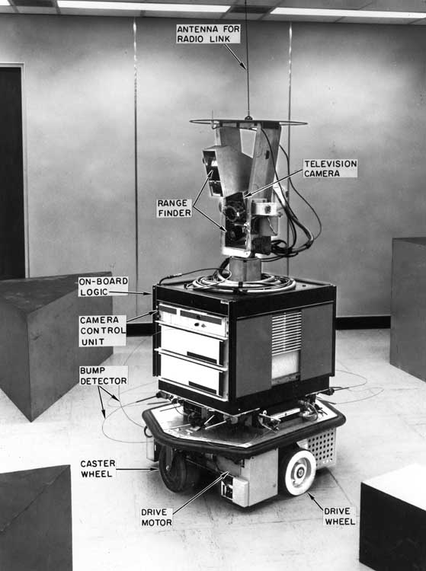
Bits of History
1969-1971: Shakey the robot (Fikes, Hart, Nilsson)
Logic-based planning (STRIPS)
Motion planning (visibility graph)
Inductive learning (PLANEX)
Computer vision

Slide 16
Bits of History
Knowledge-is-Power period (late 60’s to mid 80’s):
Focus on narrow tasks require expertise
Encoding of expertise in rule form: If: the car has off-highway tires and 4-wheel drive and high ground clearance Then:
the car can traverse difficult terrain (0.8)
Knowledge engineering
5th generation computer project
CYC system (Lenat)

Slide 17
Bits of History
AI becomes an industry (80’s – present):
Expert systems: Digital Equipment, Teknowledge, Intellicorp, Du Pont, oil industry, …
Lisp machines: LMI, Symbolics, …
Constraint programming: ILOG
Robotics: Machine Intelligence Corporation, Adept, GMF (Fanuc), ABB, …
Speech understanding
Information Retrieval – Google, …

Slide 18
Bits of History
The return of neural networks, genetic algorithms, and artificial life (80’s – present)
Increased connection with economics, operational research, and control theory (90’s – present)

Slide 19
Predictions and Reality … (1/3)
In the 60’s, a famous AI professor from MIT said: “At the end of the summer, we will have developed an electronic eye”
As of 2002, there is still no general computer vision system capable of understanding complex dynamic scenes
But computer systems routinely perform road traffic monitoring, facial recognition, some medical image analysis, part inspection, etc…

Slide 20
Predictions and Reality … (2/3)
In 1958, Herbert Simon (CMU) predicted that within 10 years a computer would be Chess champion
This prediction became true in 1998
Today, computers have won over world champions in several games, including Checkers, Othello, and Chess, but still do not do well in Go

Slide 21
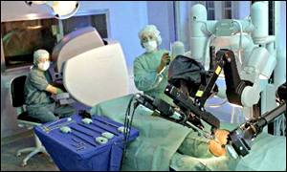
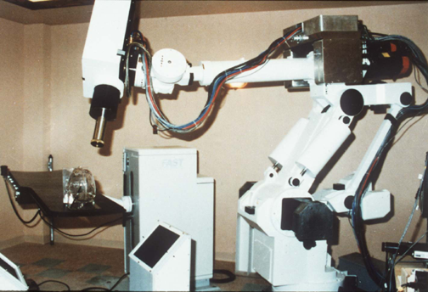
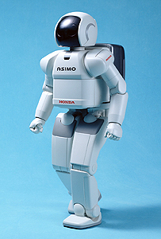

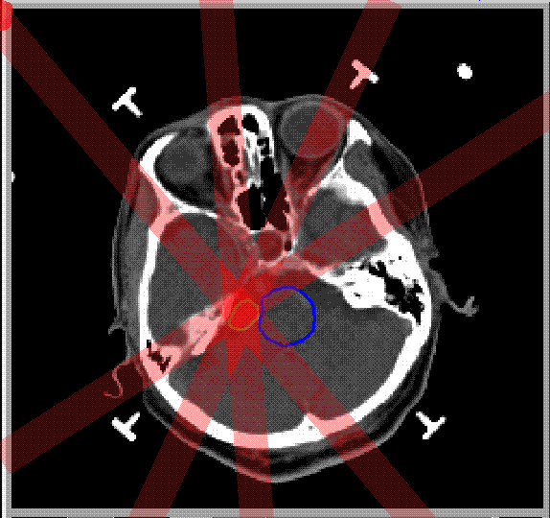
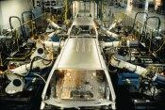
Predictions and Reality … (3/3)
In the 70’s, many believed that computer-controlled robots would soon be everywhere from manufacturing plants to home
Today, some industries (automobile, electronics) are highly robotized, but home robots are still a thing of the future
But robots have rolled on Mars, others are performing brain and heart surgery, and humanoid robots are operational and available for rent (see: http://world.honda.com/news/2001/c011112.html)

Slide 22
Why is AI Hard?
Computational Intractability
AI goal defined before notion of NP-completeness
people thought to solve larger problems we simply need larger/faster computers
didn’t understand the notion of exponential growth
ALL of the algorithms we will study will be computational intractable (NP-complete as best) in the WORST case …
How does the fact that we are dealing with the REAL WORLD make solving these computationally challenging problems feasible IN PRACTICE?

Slide 23
This Class …
We will focus on the rational agents (“engineering”) paradigm
Make computers act more intelligently
techniques: search, learning, constraint satisfaction, decision theory
tasks: perception, commonsense reasoning, planning

Slide 24
Goals for Class
You will learn a bunch of tools that are useful for building useful, adaptive software… to solve fun and challenging problems
These tools will be useful for you whether you go into AI research (basics that anyone should know) or any other discipline
Help you separate hype from what’s easily achievable using existing tools (and avoid reinventing them!)

